Slide 1

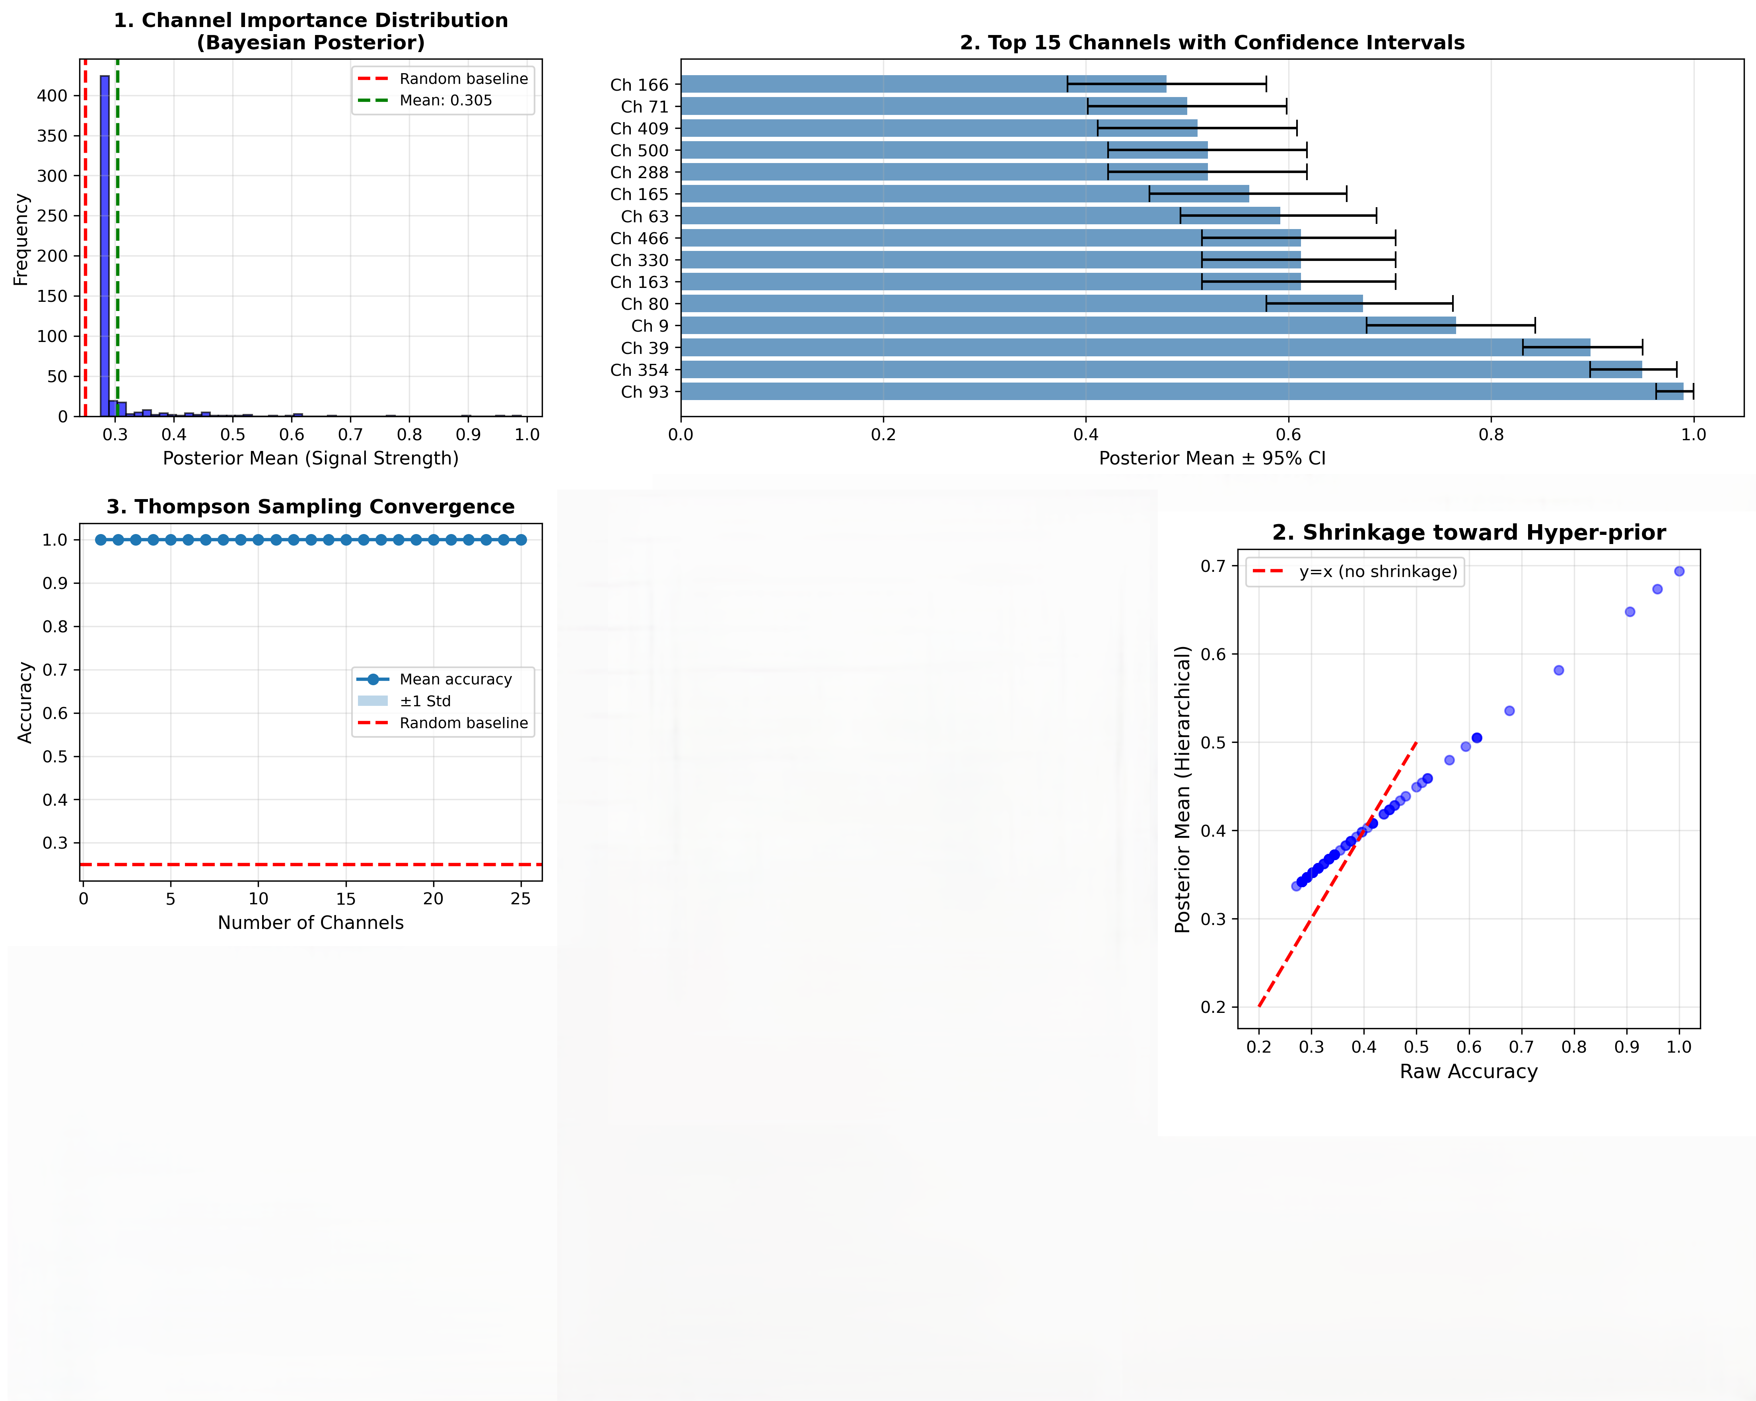
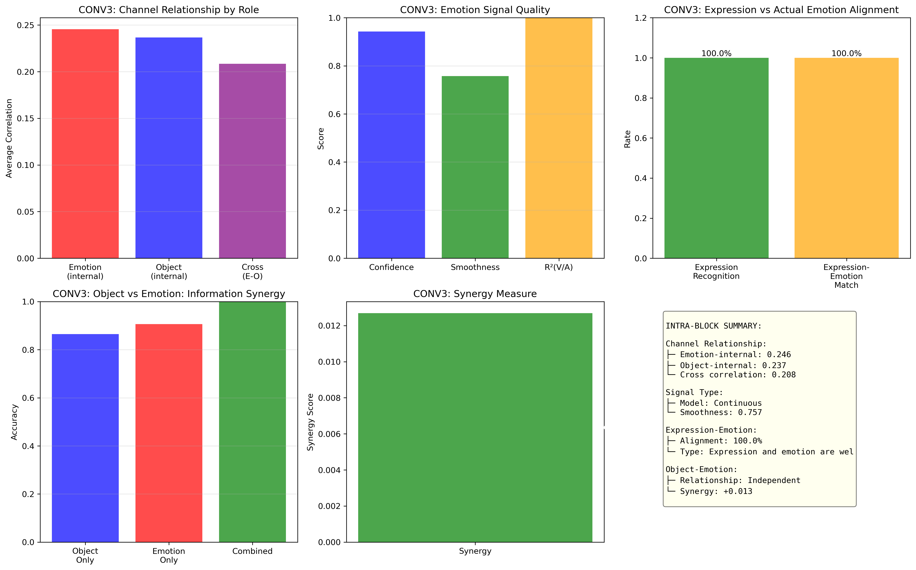
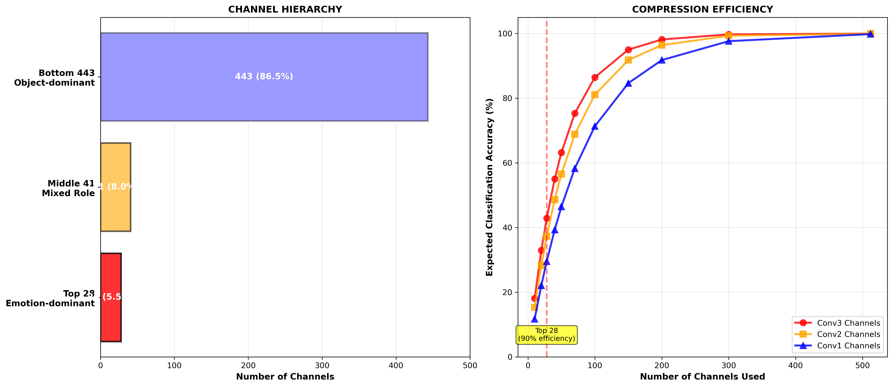
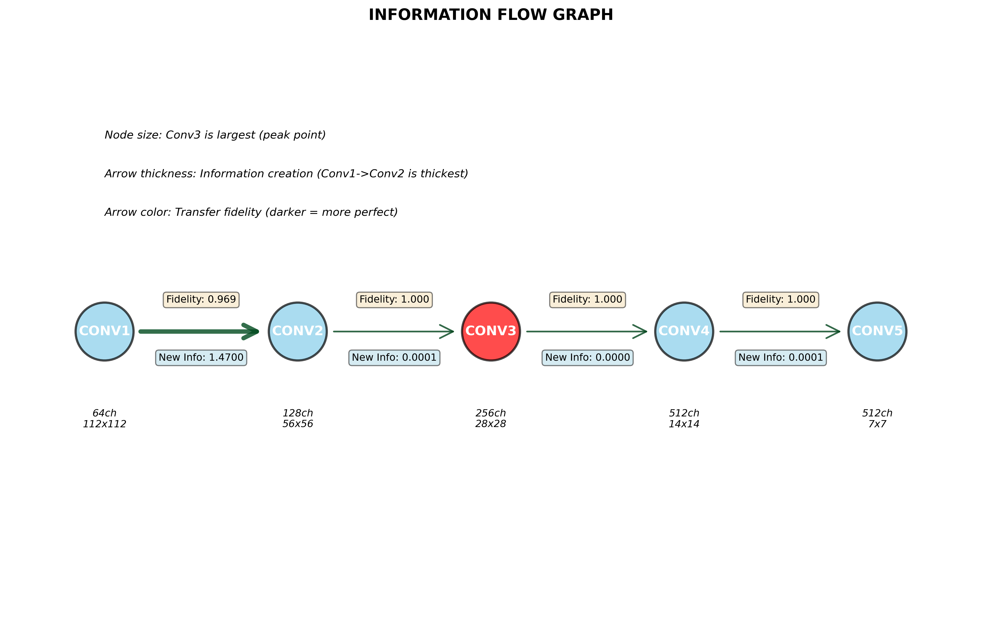

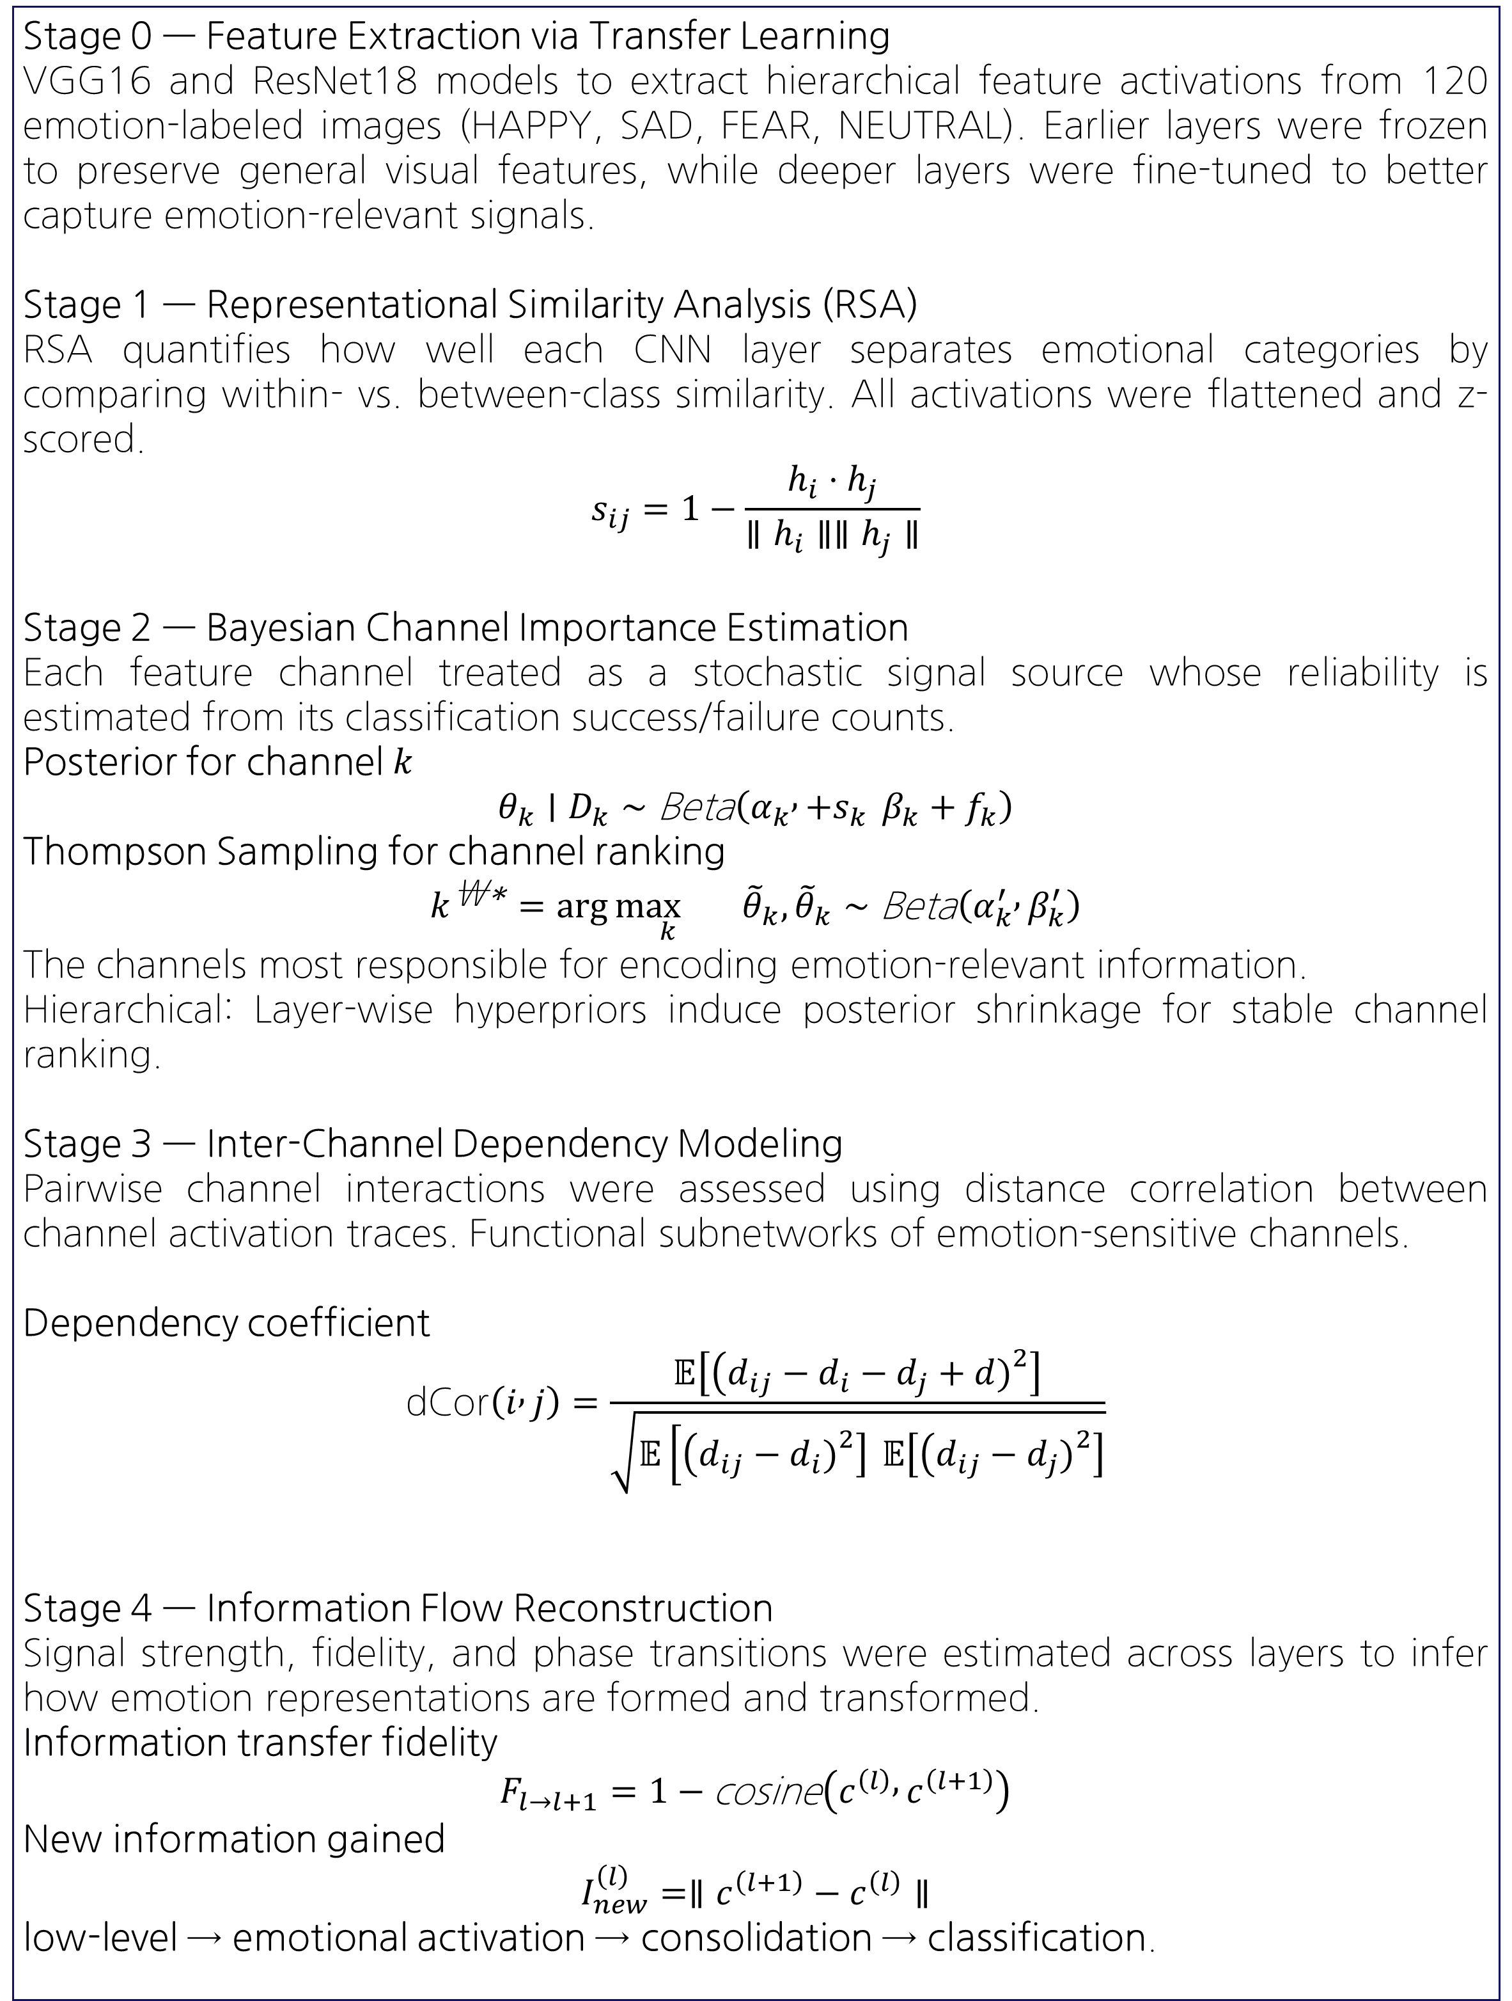
Hierarchical Emergence of Emotion
in Deep Visual Representations
서울대학교 농경제사회학부 지역정보학전공
이재원
spikasta@snu.ac.kr
INTRODUCTION
RESULTS
Emotion recognition is poorly understood in terms of where and how emotion-relevant information emerges within hierarchical visual representations. Using Convolutional Neural Network(CNN)s as computational analogs of the visual cortex, we can analyze how emotional signals are formed, concentrated and transferred across inside and different layer. Results suggest a canonical processing pipeline from early abstraction to mid-layer consolidation and final decision.
a.
b.
c.
(a) Hierarchical Bayesian inference shrinks noisy channel estimates toward layer-specific priors, stabilizing signal strength while preserving high-performing channels.
(b) A small subset of channels exhibits consistently high posterior means with tight confidence intervals, indicating concentrated emotion-relevant information.
(c) Thompson sampling rapidly converges to the optimal channel subset, confirming efficient identification of informative channels far above chance level.
OBJECTIVES
Integrating a unified framework to explain how neural systems systematically process emotions from sensory input to behavioral output.
To identify where emotion-relevant information emerges across the CNN hierarchy, by quantifying layer-wise representational separability of emotional categories.
To isolate the minimal set of channels that encode emotion with high confidence, using Bayesian inference and Thompson sampling to estimate channel-level reliability.
To characterize how emotional information is consolidated and transferred across layers, through inter-channel dependency analysis and information flow reconstruction.
(d) Emotion-related channels show stronger internal coherence than cross-domain correlations,
indicating a distinct affective subspace emerging at Conv3.
(e) Combining object and emotion features yields higher accuracy than either alone,
demonstrating synergistic integration without representational entanglement.
d.
e.
f.
g.
h.
METHODS
Stage 0 — Feature Extraction via Transfer Learning
VGG16 and ResNet18 models to extract hierarchical feature activations from 120 emotion-labeled images (HAPPY, SAD, FEAR, NEUTRAL). Earlier layers were frozen to preserve general visual features, while deeper layers were fine-tuned to better capture emotion-relevant signals.
Stage 1 — Representational Similarity Analysis (RSA)
RSA quantifies how well each CNN layer separates emotional categories by comparing within- vs. between-class similarity. All activations were flattened and z-scored.
$$s_{ij}=1−\frac{h_{i}⋅h_{j}}{∥h_{i}∥∥h_{j}∥}$$
Stage 2 — Bayesian Channel Importance Estimation
Each feature channel treated as a stochastic signal source whose reliability is estimated from its classification success/failure counts.
Posterior for channel $k$
$$θ_{k}∣D_{k}∼\text{Beta}\left(α_{k} , +s_{k} β_{k}+f_{k}\right)$$
Thompson Sampling for channel ranking
$$k^{\text{\backslash }\text{∗}}=\arg{\underset{k}{\max{}}} {\tilde{θ}}_{k}, {\tilde{θ}}_{k}∼\text{Beta}\left(α_{k}^{′} , β_{k}^{′}\right)$$
The channels most responsible for encoding emotion-relevant information.
Hierarchical: Layer-wise hyperpriors induce posterior shrinkage for stable channel ranking.
Stage 3 — Inter-Channel Dependency Modeling
Pairwise channel interactions were assessed using distance correlation between channel activation traces. Functional subnetworks of emotion-sensitive channels.
Dependency coefficient
$$\text{dCor}\left(i , j\right)=\frac{𝔼\left[\left(d_{ij}−d_{i}−d_{j}+d{\left.)\right.}^{2}\right]\right.}{\sqrt{𝔼\left[\left(d_{ij}−d_{i}{\left.)\right.}^{2}\right] 𝔼\left[\left(d_{ij}−d_{j}{\left.)\right.}^{2}\right]\right.\right.}}$$
Stage 4 — Information Flow Reconstruction
Signal strength, fidelity, and phase transitions were estimated across layers to infer how emotion representations are formed and transformed.
Information transfer fidelity
$$F_{l→l+1}=1−\text{cosine}\left(c^{\left(l\right)} , c^{\left(l+1\right)}\right)$$
New information gained
$$I_{new}^{\left(l\right)}=∥c^{\left(l+1\right)}−c^{\left(l\right)}∥$$ low-level → emotional activation → consolidation → classification.
(f) Most channels remain object-dominant, while a small subset of mid-level channels becomes emotion-selective, indicating sparse and hierarchical affective encoding.
(g) Emotion classification accuracy saturates rapidly, with only 28 Conv3 channels capturing over 90% of the full-model performance.
(h) Information flow analysis reveals Conv3 as a bottleneck layer where emotional information peaks before redistribution in deeper layers.
CONCLUSIONS
1. Emotion representations emerge non-uniformly across the CNN hierarchy, demonstrating that affective information is concentrated at a specific computational stage.
2. Information flow analysis reveals a two-stage process: substantial feature transformation in early layers, followed by near-perfect fidelity transfer into the representational peak.
3. Small subset of channels carry a majority of affect-relevant signals; the top 28 channels reproduce more than 90% of the full-model performance
4. Hierarchical Bayesian modeling confirms that emotional channels exhibit stable, high-confidence posteriors across priors and sampling schemes, suggesting that emotional coding is a robust property of the network and not an artifact of training noise or dataset imbalance.
REFERENCES
Barrett, Lisa Feldman, and Ajay B. Satpute. "Historical pitfalls and new directions in the neuroscience of emotion." Neuroscience letters 693 (2019): 9-18.
Kragel, Philip A., et al. "Decoding spontaneous emotional states in the human brain." PLoS biology 14.9 (2016): e2000106.
Kriegeskorte, N- ikolaus, Marieke Mur, and Peter A. Bandettini. "Representational similarity analysis-connecting the branches of systems neuroscience." Frontiers in systems neuroscience 2 (2008): 249.
Yamins, Daniel LK, et al. "iPerformance-optimized hierarchical models predict neural responses in higher visual cortex." Proceedings of the national academy of scences 111.23 (2014): 8619-8624.
Zhou, Bolei, et al. "Interpreting deep visual representations via network dissection." IEEE transactions on pattern analysis and machine intelligence 41.9 (2018): 2131-2145.

